Slide 1
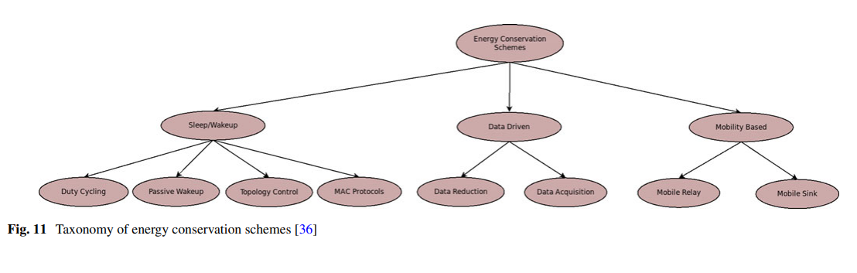
Energy Conservation:
Energy conservation which focus on the reduction of energy consumption in IoT devices. There are many schemes to conserve the energy like duty cycling, data reduction, etc.
Energy Conservation:

Slide 2
Energy Conservation:
Sleep/Wake-up:
There are some state slots when these nodes do not communicate. These are called idle states.
Nodes also consume energy in these states. Thus, idles states are the main reasons of energy consumption in the nodes.
During the idle states, nodes can go to sleep state so that they require less power.
Switching between the sleep and wake-up states is the main concept of sleep/wake-up schemes.
The node is switched On when it communicates and goes to Off during inactive period.
These techniques adjust the radio state of the node to cut down the energy requirement of the node

Slide 3
These techniques can be categorized as follows:
Duty Cycling:
Duty cycle of a node is fraction of time for which node remains active during its lifetime.
These schemes schedule node’s state based on the network activity to understate idle listening.
These schemes can be divided into three categories: synchronous, asynchronous and semi-synchronous
These approaches have high sleep latency as node has to wait for the receiver to be in active state. Moreover, in some cases, a node cannot broadcast information to all of its neighboring node because they are not awake simultaneously.

Slide 4
2. Passive wake-up radios:
In the duty cycling, node switches between inactive and active states according to their duty cycle.
There can be unnecessary wake-up calls even though there is no communication.
To resolve this issue, passive wake-up radio are used to reduce the energy consumption.
Passive wake-up radios are low power consuming radio which awake the node when data transmission is required.

Slide 5
3. Topology control:
To find out the optimal subset of nodes which guarantee connectivity is known as the topology control.
Then it is possible to deactivate some node at a time and active them later to prolong the life of network.
topology control focuses on adapting network topology dynamically according to the application requirement
4. MAC Protocol:
Collision and control packet overheads are also reasons for the energy deficiency in the sensor networks.
Thus, several MAC protocols have been proposed with low energy consumption.
MAC protocols can be classified into three categories given as: Contention based, TDMA based and hybrid protocols.

Slide 6
2. Data Driven: These approaches aim at the data reduction to be communicated for saving the energy.
data driven approaches are used to limit sensing tasks and the unneeded sampling because both the data acquisition and transmission are expensive in terms of energy.
Such approaches can be divided into two classes: data reduction and data acquisition schemes.
1. Data Reduction: These approaches address the issue of redundant data samples. Such schemes aim at reducing the data to be communicated to sink node.

Slide 7
a. Data Compression: Data compression is the process of modifying, converting or encoding the data in such a way that the new representation requires less space than the original.
b. Data Prediction: these techniques assist in reduction of energy consumption by decreasing the number of communication between sink and source node. Data prediction approaches can be divided further into stochastic, time series forecasting and algorithmic approaches.

Slide 8
c. Data Aggregation:a node receives data from several sources. But it forwards only aggregated value. An intermediate node between the sources and sink node performs the data aggregation.
2. Data Acquisition:
Only reducing the data communication is not sufficient, energy saving schemes also need to focus on the data sampling rate.
focuses on the reduction of energy consumption of node’s sensing unit.
Adaptive Sampling:This group of techniques exploit the temporal and spatial correlation of data to reduce the data sampling rate.
Hierarchical Sampling:These schemes select which sensor class to activate dynamically to find out a trade off between energy conservation and accuracy.
Model-based Active Sampling: These schemes are based on prediction. These techniques exploit this model to cut down the frequency of data sampling which assist in reduction of energy consumption

Slide 9
Mobility Based Scheme:
Recently, mobility of node has been considered for energy-efficient data gathering in sensor networks.
mobilizer can be equipped with the sensor to change its location, but mobilizers are quite costly from the energy consumption point of view.
On the other hand, instead of using mobilizer, sensors can be deployed into mobile elements like car, animals, bus, etc. In this case, there is no extra energy consumption but mobility pattern of mobile element need to be considered.
Mobile nodes can be part of network or it can be part of environment. When a mobile node is part of network, it can be controlled completely. In another case when node is part of environment, it might not be possible to control it.

Slide 10
When the nodes are static, some nodes on a particular path are more loaded than the others
Specially nodes near to sink node consume more energy because they have to receive and forward each packet directed towards sink node
Mobility-based approaches can be categorized based on whether relay node is mobile or sink node is mobile
1. Mobile Relay:
In this model, relay nodes move across the network and collect the data from source node. The mobile relay node carry the acquired data and forward it towards the sink node.
2. Mobile Sink:
a sink is considered to be mobile which acquire the data from source nodes in the network so that network lifetime can be increased.
In mobile sink model, mobile sink moves to a limited number of positions. If some nodes are not in coverage area of mobile sink node, then they can transfer data using multi-hop path.

Slide 11
Load Balancing
Load balancing is the procedure of shifting the workload to the various servers to advance the performance of the system
The workload of the machine can be defined as the total processing time that a machine calls for, to execute its tasks.
Load balancing in virtual machines will make sure that no available machine is idle.
If the load is not properly balanced dynamically then the services provided by the cloud end up in failure.
It has to ensure that every device within the network has identical quantity of load at any point of time.

Slide 12
The condition to be considered is that any server should not be less utilized or overburdened.
If any server is getting overburdened immediately, the load balancer must identify the server which is less utilized and transfer load on the respective node.
If the load balancer is not available for any server pool, the users will be in queue waiting for the response
The factors that are to be considered for the balance of load are Central Processing Unit Processing rate, Job transfer rate, response time, request time, load on each server in the pool, etc

Slide 13
Load balancing is not only limited to resource management but also includes the traffic management which is well distributed among few backend servers
This complete setup or process is well known as a server pool.
Optimizing the resources is the main aim of Load Balancing which must result in providing service for the concurrent requests.
To fulfill the high volumes of request, service providers include extra servers with some load balancing techniques.
When the demand of the application increases, there is always an option of increasing the servers as per demand.
Cloud load balancing involves the distribution of workload traffic and demands that live over the net

Slide 14
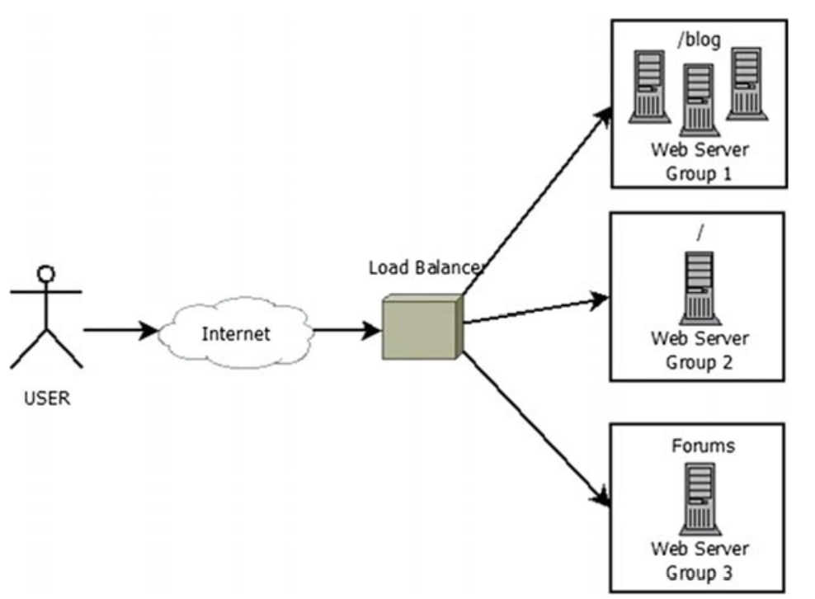
Working of Load Balancing

Slide 15
A server pool contains many servers for providing the service
The moment an application server starts to receive more requests which result in more traffic, from the pool of servers all the new requests are directed to the new server
For enlightening the services like security, performance and to attain the advanced level of application delivery An Application Delivery Controller (ACD) is used.
There are varieties of load balancing techniques which fall in three categories

Slide 16
Sender Initiated is where the algorithm is initiated by the sender and waits until a receiver is assigned.
Receiver initiated where the receiver sends a request to acknowledge a sender to share a workload.
Symmetric algorithm type is initialized by both for a smooth balancing of load.

Slide 17
Hardware Versus Software Load Balancing
Conventional load balancing solutions rely upon proprietary hardware housed in a datacenter, and require a team of sophisticated IT employees to put in, track, and hold the device.
In the age of cloud computing, hardware-based solutions have some other severe disadvantages like cloud load balancing is not supported, as the infrastructure providers usually do not allow purchaser or proprietary hardware to know about their environment.

Slide 18
Software-based load balancers can supply the performance and reliability advantages over hardware-based solutions at low cost.
Software-based run on commodity hardware, they are less costly and can be affordable even for smaller companies.
It is best for cloud load balancing, as they run inside the cloud like any other software

Slide 19
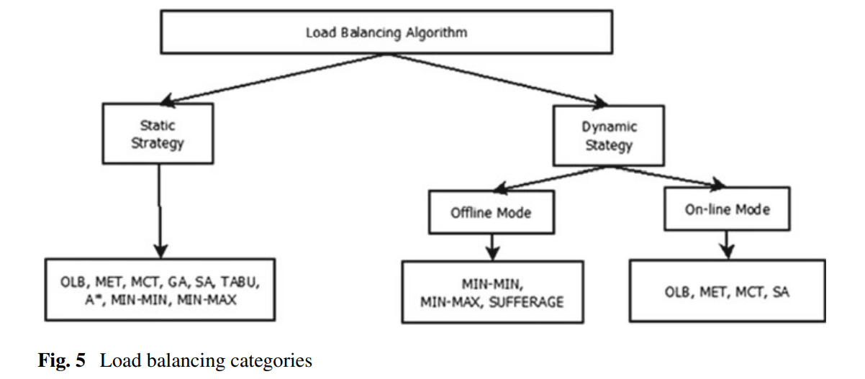
Load Balancing Algorithms

Slide 20
Load Balancing Algorithms
Static Algorithms
Static algorithms divide the traffic equally among the servers. The algorithm helps to distribute the traffic among the pool of available servers without any problem.
One such algorithms are round robin algorithm. Though it has got its limitations, an extended version of it is being developed called as weighted round robin algorithm.
This improved algorithm assigns a weight on the basis of number of connections it has. All the weights are distributed among the pool of servers would be the same, if the connections distributed are same.

Slide 21
Dynamic Algorithms
These algorithms search the whole network and identify the server which has less connections and less load when compared to other servers, then it elects proper weights on servers.
In real- time systems when networks are overloaded and leads to adding a new server to the network will help to balance the load dynamically.

Slide 22
Issues of Energy Conservation in IoT
Different issues pertaining to energy conservation can be categorized as:
• Day-to-day energy engagement
• Smart analysis and planning
• Proactive and preventative maintenance
• Employee involvement and satisfaction.

Slide 23
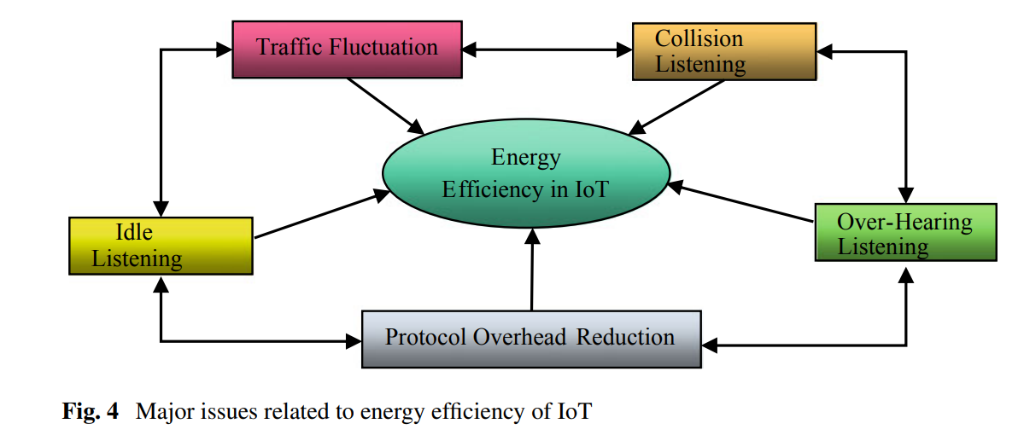

Slide 24
major issues pertaining to energy efficiency of IoT
• Idle Listening
• Collision
• Overhearing
• Reduction of protocol overhead
• Traffic Fluctuation

Slide 25
• Idle Listening
Energy utilization is major while the node is in active mode.
It is even true when node is sitting idle and waiting for its turn to transmit the data.
In the idle state, the node is only monitoring its surroundings rather than receiving or sending the packets.
In order to overcome this issue, provision is there to turn back the sensor nodes from sleeping mode to active mode after a predefined interval of time or after processing of a wake-up signal..

Slide 26
• Collision
Collision occurs when the nodes get different data packets in the meantime.
Further, because of the collision, all the received data become pointless.
In this case, retransmission has to be carried out which will cause excess energy consumption.
Collision increases latency as well and these transactions could take considerable amount of energy.

Slide 27
Overhearing
During the data transformation, interference may occur with the neighboring node which is termed as overhearing.
It has been observed that the nodes within reach possess this particular problem and leads to burn up energy resources.

Slide 28
Reduction of protocol overhead
The protocol header information also exhausts the energy resources.
That’s why it is recommendable to use some methods to reduce the overhead such as adaptive transmission periods, cross-layering approaches, and optimized flooding.

Slide 29
Traffic Fluctuation
Fluctuations in the network traffic may cause high delay or congestion.
Further, if there is maximum traffic on the network provided the network is functioning with its utmost efficacy then congestion will raise up to a substantial apex level.

Slide 30
Basic model of smart home system
A complete smart home system includes internet connectivity, smart home gateway, and multiple end devices.
Smart homes focus on providing ease of access for all wirelessly connected devices from within the home and outside the home, i.e., locally or remotely using internet.
All networked devices are connected through a gateway which controls the overall functioning of the system

Slide 31
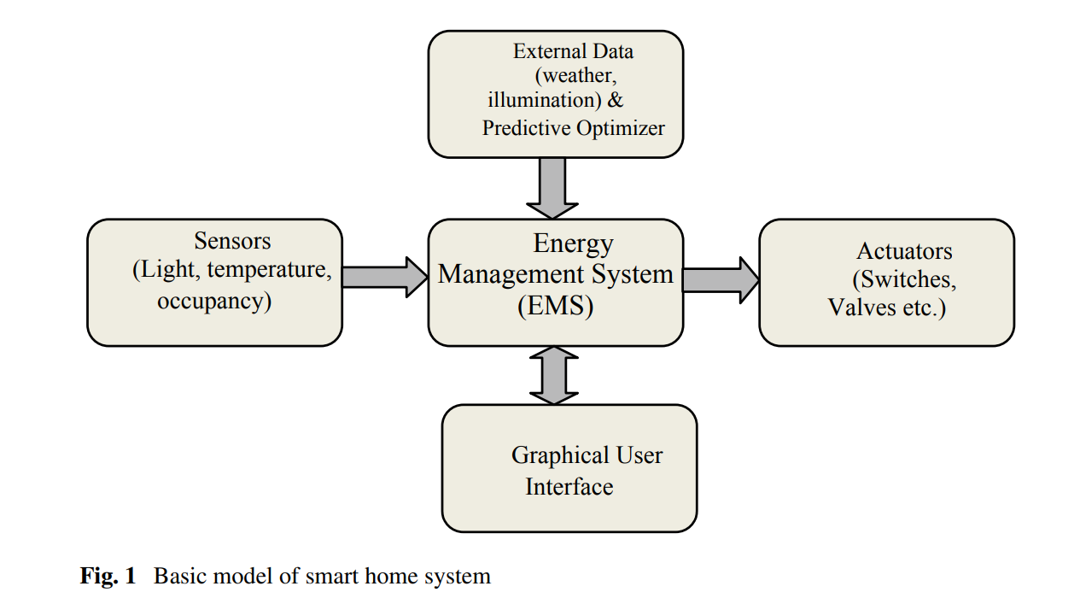
Basic model of smart home system

Slide 32
Basic model of smart home system
As illustrated in the basic model of smart home system, the core part is energy management system (EMS).
EMS obtains information about the environment through various sensors which have been deployed in the environment.
Plenty of sensors are available to fetch various parameters like heat, light, occupancy, noise level, etc.
EMS analyzes this data received from sensors in reference to external data and input from Graphical User Interface

Slide 33
Basic model of smart home system
major classes of devices in smart home:
Household Appliances refer to devices which are controlled by a microcontroller for their automatic operation.
Meters include devices which communicate with grid in real time.
HVAC includes devices related to heating, ventilation, and air conditioning, and related sensors.
Environmental Control Devices consists of devices which are controlled in response to environmental factors
Consumer Electronics contains the devices which consume constant as well as low energy.

Slide 34
Basic model of smart home system
User Interaction: It can be used to understand consumers’ behavior and statistical analysis.
Control Parameters: It is used to anticipate and predict any unpleasant incident in future.
External Data is the data obtained from external environment.
Derived Data is obtained after processing the obtained data.

Slide 35
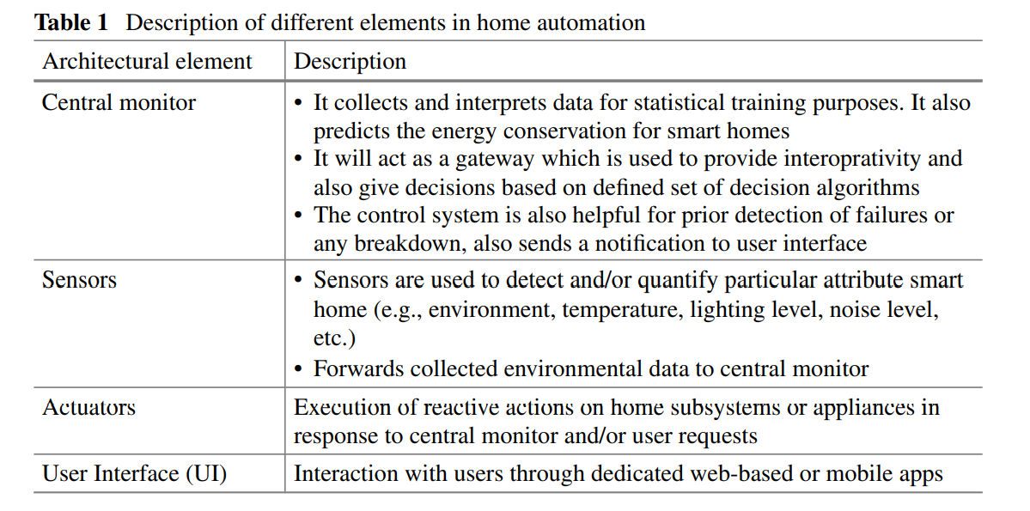
Basic model of smart home system

Slide 36
Basic model of smart home system
Communication Technologies
Various technologies are also currently available for home automation, among these available technologies, WIFI outperforms other technologies in terms of its ease of usage, large coverage, higher bandwidth, etc.
However, WIFI has higher power requirement in comparison to ZigBee and Bluetooth, popular communication protocols.
Furthermore, Z-wave is further low-cost alternative of the ZigBee and therefore Z-Wave protocol has gained popularity since its origin. Another reason for acceptance of Z-Wave protocol is its bigger range in comparison to Bluetooth

Slide 37
Basic model of smart home system
ZigBee-based intelligent self-adjusting sensor (ZiSAS) which primarily addresses the concern of cost and performance
ZiSAS uses ZigBee (IEEE 802.15.4 standard) for communication as its power requirement is low.
ZiSAS basically has two components namely self-adjusting sensor (SAS) and a sensor management agent (SMA).
SAS acquires context of environment and accordingly modifies the topology, routing protocol, and interval of data collection.
SMA performs analysis of context, pattern learning, service creation, etc. It also controls appliances through communication with sensor.

Slide 38
Basic model of smart home system
ZiSAS mainly has three layers, viz., network layer, management layer, and interface layer.
The prime features of ZiSAS are flexible middleware architecture, event-based sensor control, environment-based adjustment, and context-aware services.

Slide 39
Energy Conservation in Smart Home and IoT
The challenges in smart home solution are automation, effective utilization of sensor data, communication technology and protocols.
Automation techniques in smart home are the key component in exchanging the data between various end nodes and central control unit.
Transferring data/command to its destination should reach timely without delay.
The home automation has various activities such as acquiring data from various sensors, controlling appliance using end nodes on appliance, and exchanging command/messages between various nodes in the network

Slide 40
Energy Conservation in Smart Home and IoT
As home automation systems do not have smart algorithms to control, they are just a medium to control the appliance.
Home automation systems are managed by energy management devices
Smart energy management devices use the services/automation network to control the electrical appliance in a better way to contribute in energy conservation.
Home automation provides better control to end user in terms of security, energy management, access control, lighting, environment, surveillance.
When it is managed by energy management device, it provides data to energy management device and energy management device has various algorithms to manage different energy source in smart home.

Slide 41
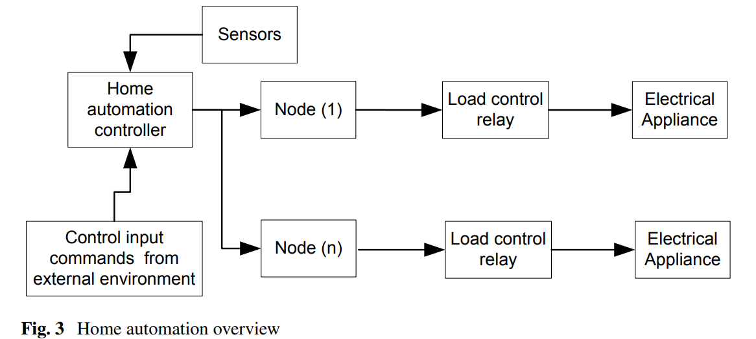
Energy Conservation in Smart Home and IoT
Automation and Sensors in Smart Home

Slide 42
Energy Conservation in Smart Home and IoT
Home automation has surveillance camera installed in the home and provide control to the user for access control mechanism.
This is a safety-related technology which uses automation techniques for user access and authorization.
Fingerprint based solutions, eye detection sensors, and voice-based security automation systems are also a part of smart home.
Home automation basic components which includes the electrical appliance control node with load control relay.
The home automation systems use end nodes to control the appliance operation (on/off) with the help of load control relay.

Slide 43
Energy Conservation in Smart Home and IoT
End node in home automation systems uses sensor data to perform control operation (on/off).
The smart operation in end node is governed by algorithms implemented in energy management system
Smart home components are the IoT control node, IoT-based sensors, control relay, etc.

Slide 44
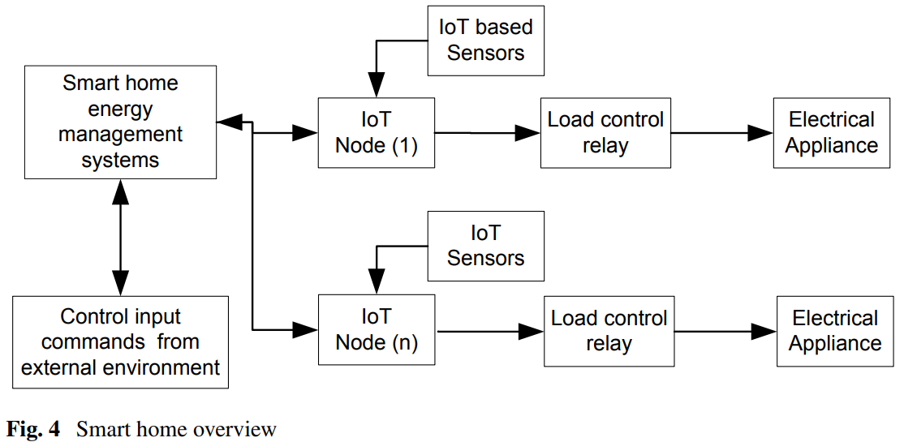
Energy Conservation in Smart Home and IoT

Slide 45
Energy Conservation Components of Smart Home
The key components of energy conservation in smart home depends on how appliances are controlled (on/off), in which communication devices are used to exchange data among network, what are the different communication protocols used to exchange data.
Smart Control Devices
Energy management system uses embedded IoT-based devices in network. Some of the IoT devices are used to control the operation (on/off) of electrical appliance. In general, control devices have sensors and load control relay. It gets data from sensors and based upon data it performs operation on appliance (on/off)

Slide 46
Energy Conservation Components of Smart Home
The simple automation based designed control devices has time-based control operation (on/off) features, where the appliance can be powered on/off with user configured time, timer-based input.
Automation based solutions has no smart algorithms for better functionality
They perform the control operation based upon sensor input and can also receive control command from external entity via main system controller.
These devices also send device status related messages to main automation device.

Slide 47
Energy Conservation Components of Smart Home
IoT Devices in Smart Home:
There are many IoT devices in smart home which are used to control the appliance and manage energy in a better way
One such products which display current consumption of home. These devices are popularly known as in-home displays [IHD], which work in association with smart energy meters.
IHD communicates with smart energy meters and read the current consumption value and display that on its display unit.
Smart energy meters are connected to utility network and get alerts/notifications from utility side which are displayed on IHD screen

Slide 48
Energy Conservation Components of Smart Home
Energy efficiency segment has various smart devices such as smart plug, IoT-based doorbell (alerts user on mobile device with motion detection), and IoT-based sensor modules.
IoT-based sensor modules also play a role in home security and safety.
They initiate the alert message when some fire/smoke is detected and can intimate the smart energy management system to automatic dial fire station/police station/medical emergency contact numbers.
IoT-based user authentication systems are also part of smart home.
These include the thumb impression identification, door camera, boundary fencing systems, face recognition-based user identification system, and voice command-based systems.

Slide 49
Energy Conservation Components of Smart Home
Communication Protocols in Smart Home
There are various protocols used in smart home to perform different activities in smart home energy management systems.
Each stage of communication has its specific role, reliability, priority of data/message, payload carrying capacity, and security of data, from these, various communication protocols are categorized for their respective contribution in the system
• Automation
– MODBUS
– LonTalk (PLC network protocol

Slide 50
Energy Conservation Components of Smart Home
Data exchange
– Wi-Fi
– Zigbee
– Bluetooth
– MQTT
Network Reliability
– TCP/IP
– IPv6
– 6LowPan
– RPL

Slide 51
Energy Conservation Components of Smart Home
Security
– AES (data encryption algorithm)
– SS7
• Network
– TSMP (time synchronized mesh protocol)

Slide 52
Energy Conservation Components of Smart Home
Wireless networks rely on communication protocols.
The perfect fit of a communication protocol in a situation depends upon the various factors as given below
– how much data to be exchanged
– network communication bandwidth
– how frequent periodic/aperiodic data will be transmitted
– number of communication devices in a network sharing one common channel
– actual data payload versus protocol overheads
– communication throughput
– authentication and data encryption
– message reliability and priority (connection-oriented/connectionless)

